Slide 1
Ashley Nicole Shannon
My Life/Mi Vida
Born-Landsthul, Germany
Bi-Lingual-English, Spanish
Senior New Mexico State University
Student - Athlete
Family, Music, Basketball and Friends

Slide 2
Aspirations in Higher Education
New Mexico State University Bachelor Degree in Criminal Justice, 2010
Minor in Psychology, 2010
Master in Criminal Justice, 2015
USAF Judge Advocate General’s Corps, 2017
Criminal Justice and Psychology

Slide 3
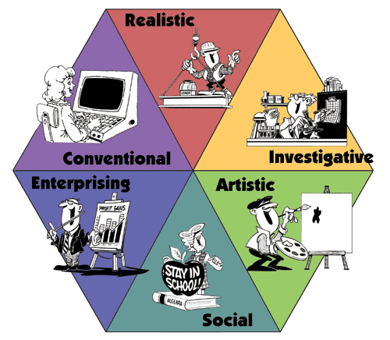
Personality Traits
PLSI Score = ISTJ, the Dutiful Fulfiller
(Introverted Sensing with Extraverted Thinking)
Dependable and Loyal
Responsible
Logical
Well Organized
Thorough

Slide 4
Expectations and the Future
International Traveler
Technological Savvy
Financially Sustainable
Community Leader
Youth Consultant
Europe
Just live life to the fullest.

Slide 5
Living the Vision
Professional Career
Family & Friends
Learning Opportunities
Overseas Travel
Cultural Diversity
Ethical
Honest
Integrity

